Slide 1

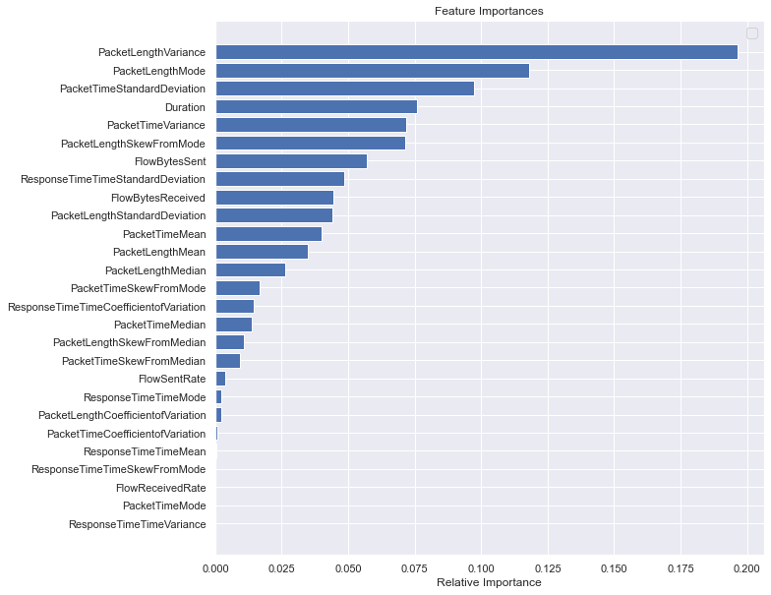
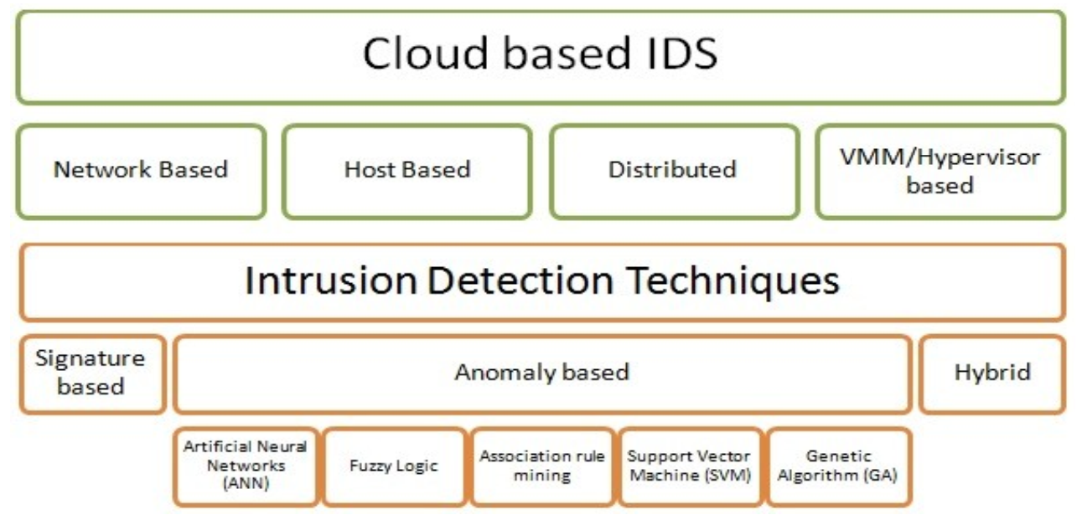
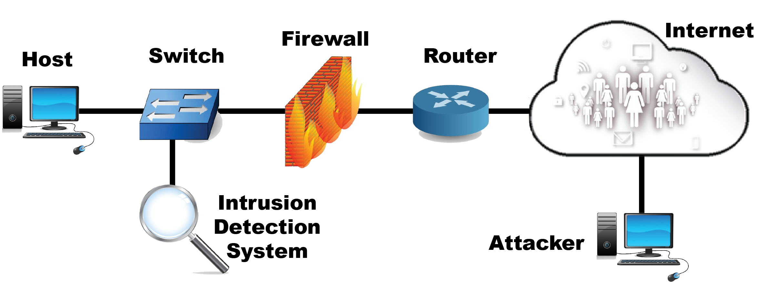
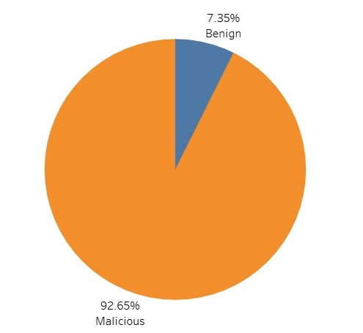
Intrusion Detection System in Cloud Computing
MIS 596 – Fundamentals of Cloud Computing and its Design Strategies
Ankeet Bhattacharya, Madhvika Sehgal, Sree Charan Shatdarsanam, Mehak Sood, Shubhang Tripathi, Pooja Tyagi
University of Arizona – Eller College of Management
Abstract
Types of Attacks:
Insider Attack
Denial of Service Attack
Access Attack
Virtualization Attack
Backdoor Channel Attack
Multitenancy Attack
Authorization, Authentication, Encryption and Identity-based Attack
Loss of Data Integrity, Unauthorized Modification and Forgery
In today’s environment, Data breaches are the most wide-scale cyber-attacks leading to loss of confidential personal information and identity theft. This is followed by Distributed Denial of Service (DDoS) attacks where the network is flooded with requests that consume the entire bandwidth and lead to a complete failure of the cloud environment.
Intrusion Detection Systems
The cloud service providers maintain a huge amount of infrastructure, and it is impossible to guarantee security within the distributed infrastructure through traditional security mechanisms. The security risks associated with the cloud require development and deployment of network monitoring systems that can protect against older and newer forms of attacks (i.e., zero-day attacks). Intrusion Detection Systems (IDS) have emerged within the security ecosystem to provide network-wide monitoring, detection and resolution in the cloud computing infrastructure. The rise of Software Defined Networking (SDNs) have enabled efficient deployment of security policies across the network and made it possible to provide cutting edge soft computing solutions within a fraction of time. IDS are designed to monitor the network traffic and detect suspicious patterns within the network traffic. By constantly keeping a check on the network, the IDS monitor traces of activity and create log files for tracking and analysis of the network. On detection of suspicious patterns or events the IDS can trigger protective measures to counter the suspicious activity and inform the relevant parties of a possible attack.
Approaches and Existing Research
Methodology
Cloud computing offers access to compute resources and services on-demand with flexible utilization-based payment models. Due to its significant advantages over traditional models, cloud computing has been widely adopted for all kinds of use-cases within the tech domain. The advent of cloud computing model and the proliferation of public cloud infrastructure has also led to increase in vulnerabilities due to the design constraints of the model. It has become increasingly important to develop security solutions that take a proactive approach towards detecting anomalies and attacks in the cloud environment. Our project aims at developing a predictive data analytics model for forecasting malicious attacks in the network. Our project presents a prototype of Network based Intrusion Detection Mechanism for identifying malicious attacks by looking at various network parameters. We built our IDS model using an optimized Random Forest classification technique to detect malicious patterns in the network traffic. We believe such a model can be deployed across the network infrastructure and further leveraged to collect more traffic data and identify malicious activity at various layers of the network for protecting the cloud infrastructure.
Cloud based IDSs can be broadly categorized in the following categories:
Network Based IDS: This type of IDS works by capturing the entire network traffic data and analyzing the IP and transport layer headers of the captured packets.
Host based IDS: These systems collect and analyze data at a host level (appln logs) to detect intrusive events.
VM/Hypervisor Based IDS: These IDS are deployed at the hypervisor level, which lets them analyze data from communication between VM’s and detection of anomalous activities.
Distributed IDS: These IDS are a combination of the other three. In practice, all cloud-based IDS systems are distributed, with various types of IDSs deployed across a large network actively monitoring data flow and communicating with each other to detect threats to the network
We have developed a robust, versatile, parallelizable, low bias Anomaly-Based Intrusion detection System that can work with high dimensional network data to predict Zero-day intrusion with an accuracy level of 90%. An optimized Random Forest classification technique deployed in this system makes it immune to outliers and non-uniform units of measurement that are used across different network data parameters.
This approach is a shift in Intrusion detection from commercially available Signature-Based Intrusion Detection systems to an Anomaly based detection by making use of Packet based characteristics. Relative importance of Packet features in identifying malicious packet from a non-malicious packet is as follows.
The top contributing feature is the Packet Length variance.
Step 1: Dataset Selection
As a promising approach for intrusion detection, Machine Learning serves as a practical solution needs massaged data sets. We have utilized the CIRA-CIC-DoHBrw-2020 open dataset developed by Canadian Institute of Cybersecurity in a two-layered approach to capture benign and malicious traffic over DoH protocol.
Step 2: Data Pre-Processing
2020
2025
$34.5 Billion
14.7% CAGR
$68.5 Billion
Fig. Cloud Security Market Size
Introduction
In recent years, the emergence and rapid adoption of cloud computing has led to the democratization of computing resources, where any user can access advanced computing capabilities for their specific use-cases, whenever required and from anywhere in the world. Moving from traditional, locally based computing to cloud computing environment has spurred the development of many new technologies that support the complex nature of distributed computing. While placing a high premium on capabilities such as reliability, scalability, consistency and fault Tolerance, the cloud environment has led to the emergence of new privacy and security concerns for the end-users. Providing high-level of customer satisfaction is of paramount importance to Cloud Service Providers (CSPs). CSPs adhere to strict Service Level Agreement (SLA) benchmarks and are responsible for providing a high Quality of Service (QoS) which includes protection of client’s information apart from meeting the high-end workload benchmarks.
The traditional approaches to detecting intrusions relies on matching the signature of attacks with known threats and on predicting user behavior. Anomaly based detection systems are a relatively newer form of intrusion detection, which works through creating a baseline of network activities and then detecting anomalies through statistics and heuristics. An anomaly-based detection system can detect attack patterns which deviate from normal. Machine Learning (ML) techniques and algorithms play a major role in helping these systems identify and alert users about potential threats and attacks. Artificial Neural Networks (ANN), Genetic Algorithm (GA) and association rule mining are some techniques currently used in these systems. The use of ML techniques in these systems requires a large amount of time and training data for them to be effective. Since there are a lot of events generated in a cloud-based system, a potential downside of using ML is a high false positive flagging rate. Nonetheless, these methods are still widely used due to their ability to use incomplete data to detect an attack on infrastructure. These search techniques involve the selection of optimal network parameters to monitor and improve the performance of the IDS
The main challenge faced in analysis has been the imbalanced dataset as shown to the left. Approaches like SMOTE (Synthetic Minority Oversampling Technique) , cross-weightage, and under sampled bootstrapping are tested and evaluated. The best prediction accuracy is obtained using bootstrap under sampling approach.
Cloud Security
Physical Security
Cyber
Security

Slide 2
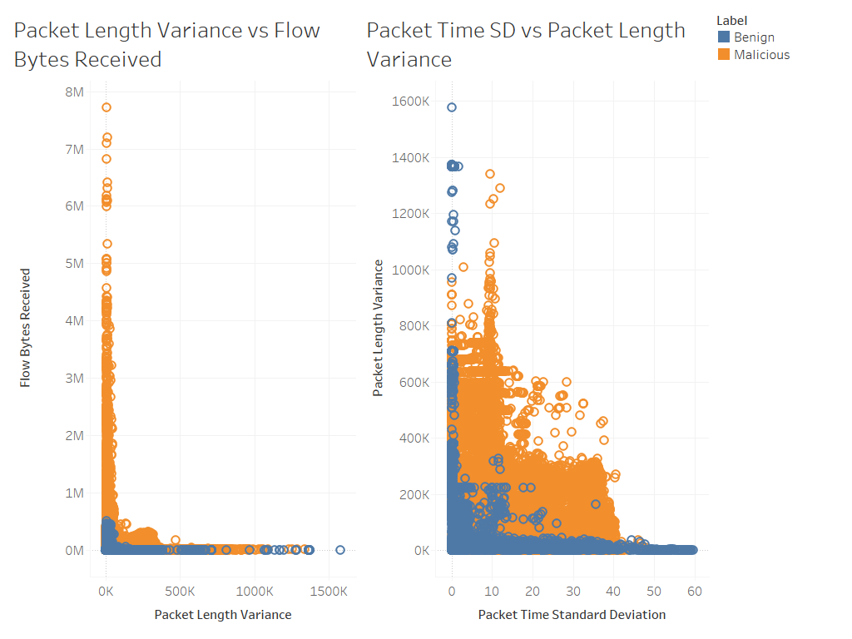
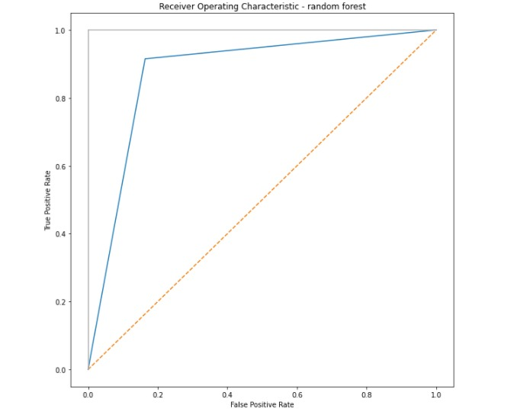
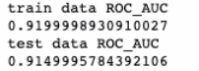
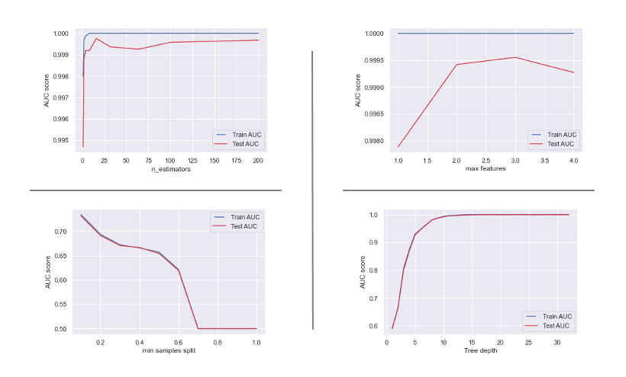

Intrusion Detection System in Cloud Computing
MIS 596 – Fundamentals of Cloud Computing and its Design Strategies
Ankeet Bhattacharya, Madhvika Sehgal, Sree Charan Shatdarsanam, Mehak Sood, Shubhang Tripathi, Pooja Tyagi
University of Arizona – Eller College of Management
Methodology (Contd.)
Evaluation & Results
Step 3: Exploratory Data Analysis
Our analysis indicated a strong inter-correlation among the predictors. We used spearman correlation coefficient and Pearson correlation to measure the interdependency (Appendix 1). Only non-correlated features are considered for further analysis. We also analyzed the distribution of values for malicious and benign labels to evaluate how these characteristics compare.
As observed in the image, there is huge difference in the flow bytes and packet length variance of malicious packets as compared to benign packets.
Step 4: Hyperparameter tuning
In order to create a generalized and optimized classification model, parameters such as number of estimators (trees), maximum tree depth, minimum sample split, minimum sample leaf and maximum features are optimized with a trial approach using AUC as the evaluation metrics.
Step 5: Developing the model
Initial analysis with decision tree resulted in a highly overfitted model with 100% accuracy on training data, rendering it impractical for generalization.
Consequently, we utilized Balanced Random Forest classification approach with optimized features observed in hyperparameter tuning. The resulting model is free from bias introduced due to imbalance in the dataset as well as overfitting.
The confusion matrix result is as below:
Pros | Cons
Visibility Provides a clear monitoring mechanism within the network | Data Dependent Last most Machine learning based systems, the data volume, integrity to train the model becomes paramount
Defense Adds a layer of defense to your security profile, providing useful backstop to some of your other security measures | More Maintenance IDS does not replace a firewall, virus scan, or any other security measure
Tracking of Virus Propagation By tracking source IPs, IDS can point potential sources of attack as well as how it is propagating through the network | False Positives IDSs are famous for setting off false positives-sounding alarm when nothing is wrong
Evidence A properly configured IDS can produce data that can form the basis for a civil or criminal case against someone who misuses your network | Experienced staff requirements The less experienced your staff are, the more they will spend responding to false positives. Therefore, you will be creating not only more work for the IT department to handle, but more difficult work in some cases
 | Precision | Recall | f1-score | Support
Benign | 0.42 | 0.93 | 0.58 | 4901
Malicious | 0.99 | 0.90 | 0.94 | 62510
Accuracy |  |  | 0.90 | 67411
Macro Avg | 0.71 | 0.91 | 0.76 | 67411
Weighed Avg | 0.95 | 0.90 | 0.92 | 67411
Further enhancement and implementation of such an IDS model can be achieved by gathering information in areas around:
Identification of assets and values that are vulnerable to the threats
Identification and Labelling of Threats and vulnerabilities
Risk Assessment & Prediction of Likelihood of occurrence for each of the classified threat
Computation of Annual Loss Expectancy and implementing control mechanisms for the detected threats
Cost-Benefit Analysis
Estimates above are based on 28th CSI Computer Security Conference
The above imbalance for Benign data having f-1 score of 0.58 is expected since there is very less support data (# of benign record count) as compared to Malicious data in our simulated data. Hence our model is highly susceptible to detecting Malicious data with lot of accuracy. This translates to:
99% True positive rate – detects malicious attacks most of the time
42% True negative rate – detects benign data and classifies correctly half of the time
Additional metric, the ROC_AOC (true positive vs false positive) curve measures the sensitivity, specify of the model. As seen below ROC_AOC of 92% shows a high classification performance at all classification thresholds.
The above results indicate that the model is quite performant at classifying malicious data with ahigh degree of precision and accuracy despite a narrow, unbalanced data set!
Market Benefits of Improving the Model
Item | Est. Amount
Disclosure and damage to confidential data
Cost to recover data: $200,000 @ 50% likelihood per year | $100,000
Effectiveness of the tool: 85% | $85,000
Cost of Tool | $40,000
ALE due to a loss and control | $55,000
Net Savings | $45,000
Model Improvements
The overall advantages and disadvantages of using such a Machine learning based IDS is inherently tied to data integrity as well as availability.
The most practical approaches to overcome the challenge of misclassifying normal network traffic data awhile improving the model accuracy need are by training the model with:
More ‘benign/normal’ network traffic data
Data packets that cover server peak load traffic scenario
References
Data Source: CIRA-CIC-DoHBrw-2020
Cloud Security Market Analysis:
FCM–SVM based intrusion detection system for cloud computing environment
A survey of intrusion detection techniques in Cloud
Cost benefit Analysis of IDS systems

Slide 3
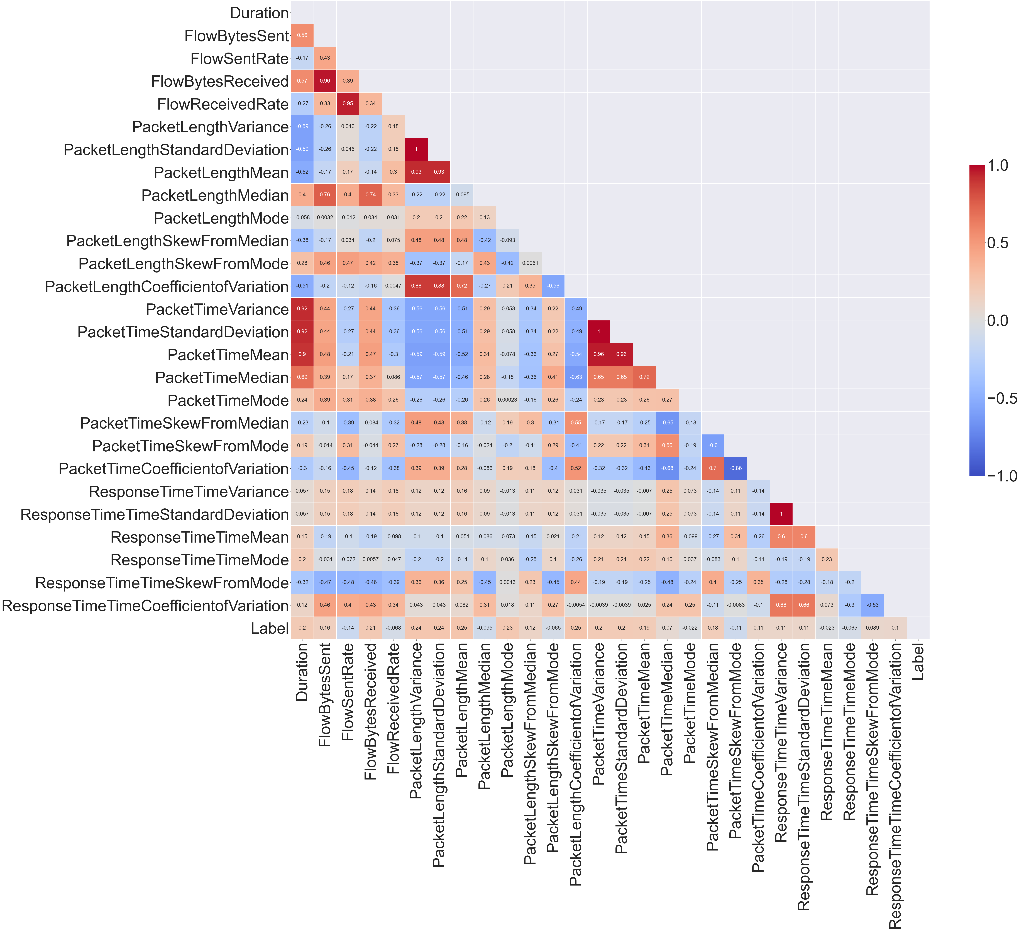
Appendix

